Slide 1
AMAN KUMAR
JIMS Engineering Management Technical Campus (JEMTEC)
GURU GOBIND SINGH INDRAPRASTHA UNIVERSITY
Name of the event:- HACKATHON

Slide 2

The theme of our project is to make our roads safer. This would be only possible when every person takes initiative that they would not drive without LICENSE, they would not drive if they are drunk or unwell.

Slide 3

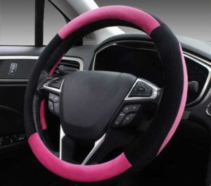
HERE IS MY IDEA
SMART STARING WHEEL + DRIVE APP
LOCATION
LICENCE
HELP

Slide 4
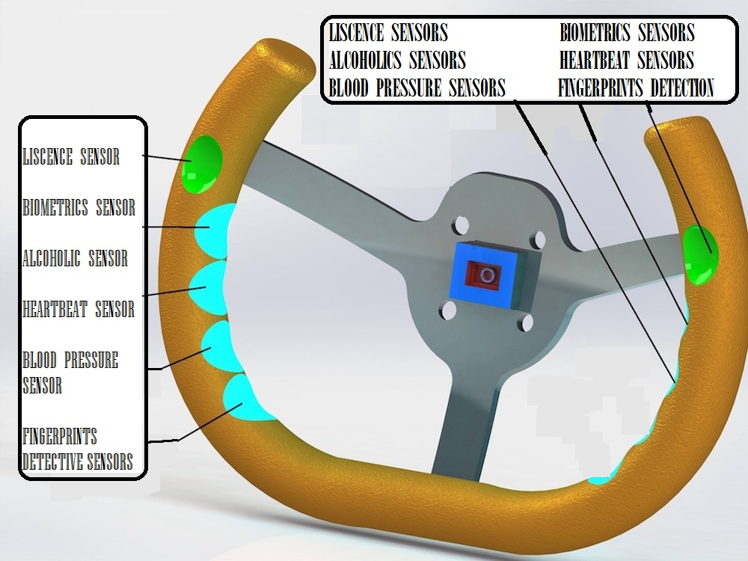
Design of the staring wheel
In further slides each features are explained.

Slide 5
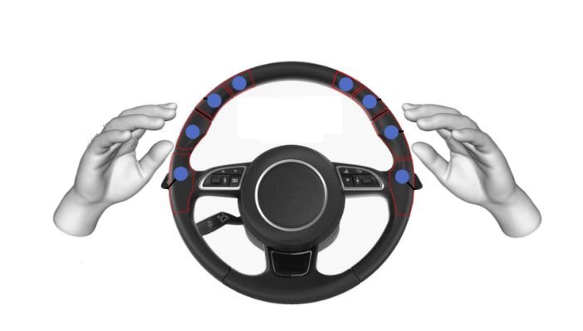
Smart digital Driving licence
In this new initiative of the project all the people have to update their licence digitally. In which every people have to provide their biometrics identity which will include fingerprints , photograph , iris image, normal blood pressure, their full address, phone number, e-mail id . All this details will be saved in Indian government database center.

Slide 6
Working of smart digital license
As in last slide we have seen that our licence will be digitalized . So, there is no need to carry physical licence anywhere .
Our smart staring wheel consists of hi-tech sensors which will scan the fingerprints of the driver and his/her details will be matched with the data provided at the license database center . If the driver fingerprints matches with the data provided at the database center then the car will be activated and he/she will be able to drive the car otherwise the car will not start.

Slide 7
Teenagers prevented from driving
In this smart vehicle the teenagers will be away from miss happening’s due to driving .
If any teenager wanted or tries to handle the vehicle then his/her identity will be scanned and matched with smart digital license if he is having the license then vehicle will start and he can drive otherwise not.
46
Children die every day on Indian roads

Slide 8
Problems of due to physical license
On some particular areas like red lights there is a huge traffic jam due to license checking by the police(traffic police) .Due to this heavy traffic jam people get late for their work and large amount of fuel(Petrol , Diesel , CNG) is wasted everyday.
In several accidents teenagers or peoples are caught driving the vehicles without license and they are untrained. Many of them tries not to pay the fine by rush driving and due to this many policeman’s are hurt or have to lose their life for no reasons.

Slide 9
Vehicle security
Vehicle security is the biggest problem in India . There are many cases in which people’s vehicles are stolen from the parking area……, etc.
Solution for problem
If any unknown person or thief tries to handle your vehicle then their identity will be scanned and forward for verification to government database and it didn't matches so , the vehicle will not start and the owner of the vehicle will get a instant notification on his DRIVE APP that his/her vehicle is in hands of any stranger . The owner can take an action like stopping the car at that moment and can reach the place by following the location received on the notification . Owner of the vehicle can also forward the strangers identification to the police by DRIVE APP.

Slide 10
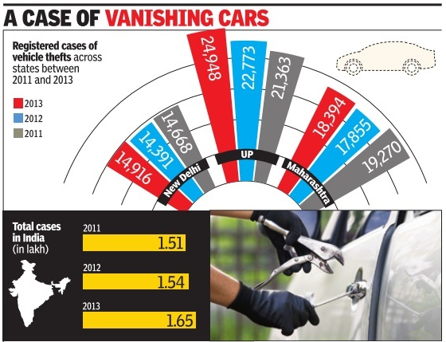

Slide 11
The problem
17
people die every hour on Indian Roads
4.07
LAKH CRORES costs to India due to road crashes annually
46
children die every day on Indian roads
50%
road crash deaths could have been avoided with rapid assistance
50 LAKH+
were seriously injured or disabled in the past decade
10 LAKH+
people were killed in road accidents over the past decade

Slide 12
prevention of drunk and drive cases
Our smart staring wheel will be provided with hi-tech(sensors) artificial intelligence which is going to learn the behavior of driver in normal conscious time and sensors will detect that the driver is conscious to drive or not . If the driver is conscious to drive the sensors will confirm it and the vehicle engine will be activated to move further. In case of driver is not conscious (by taking alcohol or any other kind of drug) then the vehicle engine will not be activated.
By using this formula we can prevent drunk and drive cases.

Slide 13
“70 per cent of road accidents in India due to drunken driving”
Country loses 1.34 lakh lives in road accidents each year
With India reporting as many as 1.34 lakh fatalities in road accidents every year, a vast 70 per cent of them being due to drunken driving, questions are now being raised on whether the mushrooming growth of liquor vends along the highways is responsible for costing precious lives in an untimely manner.
As the World Day for Remembrance of Road Traffic Victims was observed on Sunday, various organizations involved in spreading road safety awareness demanded action to bring down such incidents.
The Community Against Drunken Driving (CADD) said nearly 70 per cent of all fatalities are due to drunken driving, with the figure running between 44 per cent to 67 per cent in smaller cities. Despite prosecution of drunken driving having increased by about seven times in Delhi and 16 times in Mumbai since 2001, there has been no corresponding decrease in accidents and fatalities.

Slide 14
Help button on the drive app
Our smart driving app will be provided with a help button . It’s function is to provide a instant help to drivers in case of any miss happenings or any road accidents.
Working of button
The DRIVE APP has a HELP button which can be used in case of any miss happenings(accident) person will click the help button. A automatic message will be generated and forward to the near hospital and to there family members . After sending of the message an automatic call will also be generated only to the family members because nowadays many people actually don’t see the message box .

Slide 15
Working of hospitals in accidents
All the hospitals of India have to appoint a group of 10 special members who will work for this movement. The appointed team will be consisted of 2 doctors ,4 nurses/ward boys,2 ambulance drivers ,2 extra members to coordinate the team,2 ambulance .
In rural areas the group will consist of 5 members.
The rule to appoint a special team for each (government and private) hospital in India will be compulsory.
Working of the team
Whenever any person will click on the help button a message with accident location will reach to the special team of the nearby hospital and to there family members.
The special team will take action by sending the ambulance to the accident area.
HELP

Slide 16
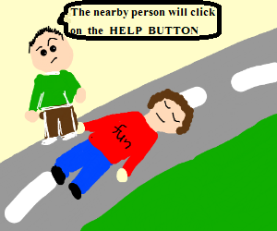
Accident occur
family
HELP
HOSPITAL
Message

Slide 17
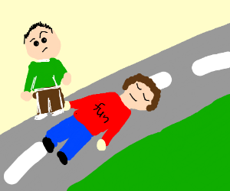
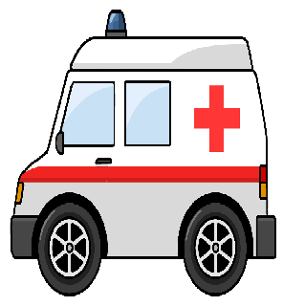

Message will reach to hospital and family members

Slide 18
IT WILL BE THE GREATEST MOVE TOWARDS THE SMART DIGITAL INDIA
SMART DRIVE SAVE LIFE

Slide 19
BIBLIOGRAPHY
All the STATISTICS of the accidents , vehicle theft , etc. for the project has been taken from various sources such as :-
Websites
www.knoema.com
WWW.IRSC.Com
Newspaper
THE HUNDU
TIMES OF INDIA , etc.

Slide 20
THANK YOU

